Slide 1
CPU Architecture
Presentation By:
Anthony Cerritelli, Bryan Bigelow, Robert Rotaru

Slide 2
Introduction
The CPU is one of the largest heat generators in a computer.
Requires highly purified silicon, the material it’s built on, that is a scarce natural resource.
Acts as the main instruction center of the device.

Slide 3
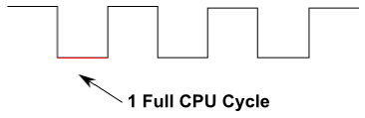
Architecture
Single-Cycle Datapath – Instructions you give to the processor are determined on a clock cycle.
Negative Edge – Instructions are processed on the “bottom”, or 0, of the clock cycle.
16-Bit Architecture - 0000 0000 0000 0000 would be a 16-bit input.

Slide 4
Architecture (Part 2)
Broken into five activity phases:
IF (Instruction Fetch) – Provides the current program location (program counter) and loads the instruction.
ID (Instruction Decode) – Retrieves or writes memory to a “register”, a piece of memory dedicated to the CPU.
EX (Execute) – Mostly contains the ALU (Algorithmic Logic Unit) and handles most of the logic or math of the unit.
MEM (Memory Access) – Accesses the memory of the computer for storage or retrieval
WB (Write Back) – Writes value calculated in EX or retrieved from MEM into a register.

Slide 5
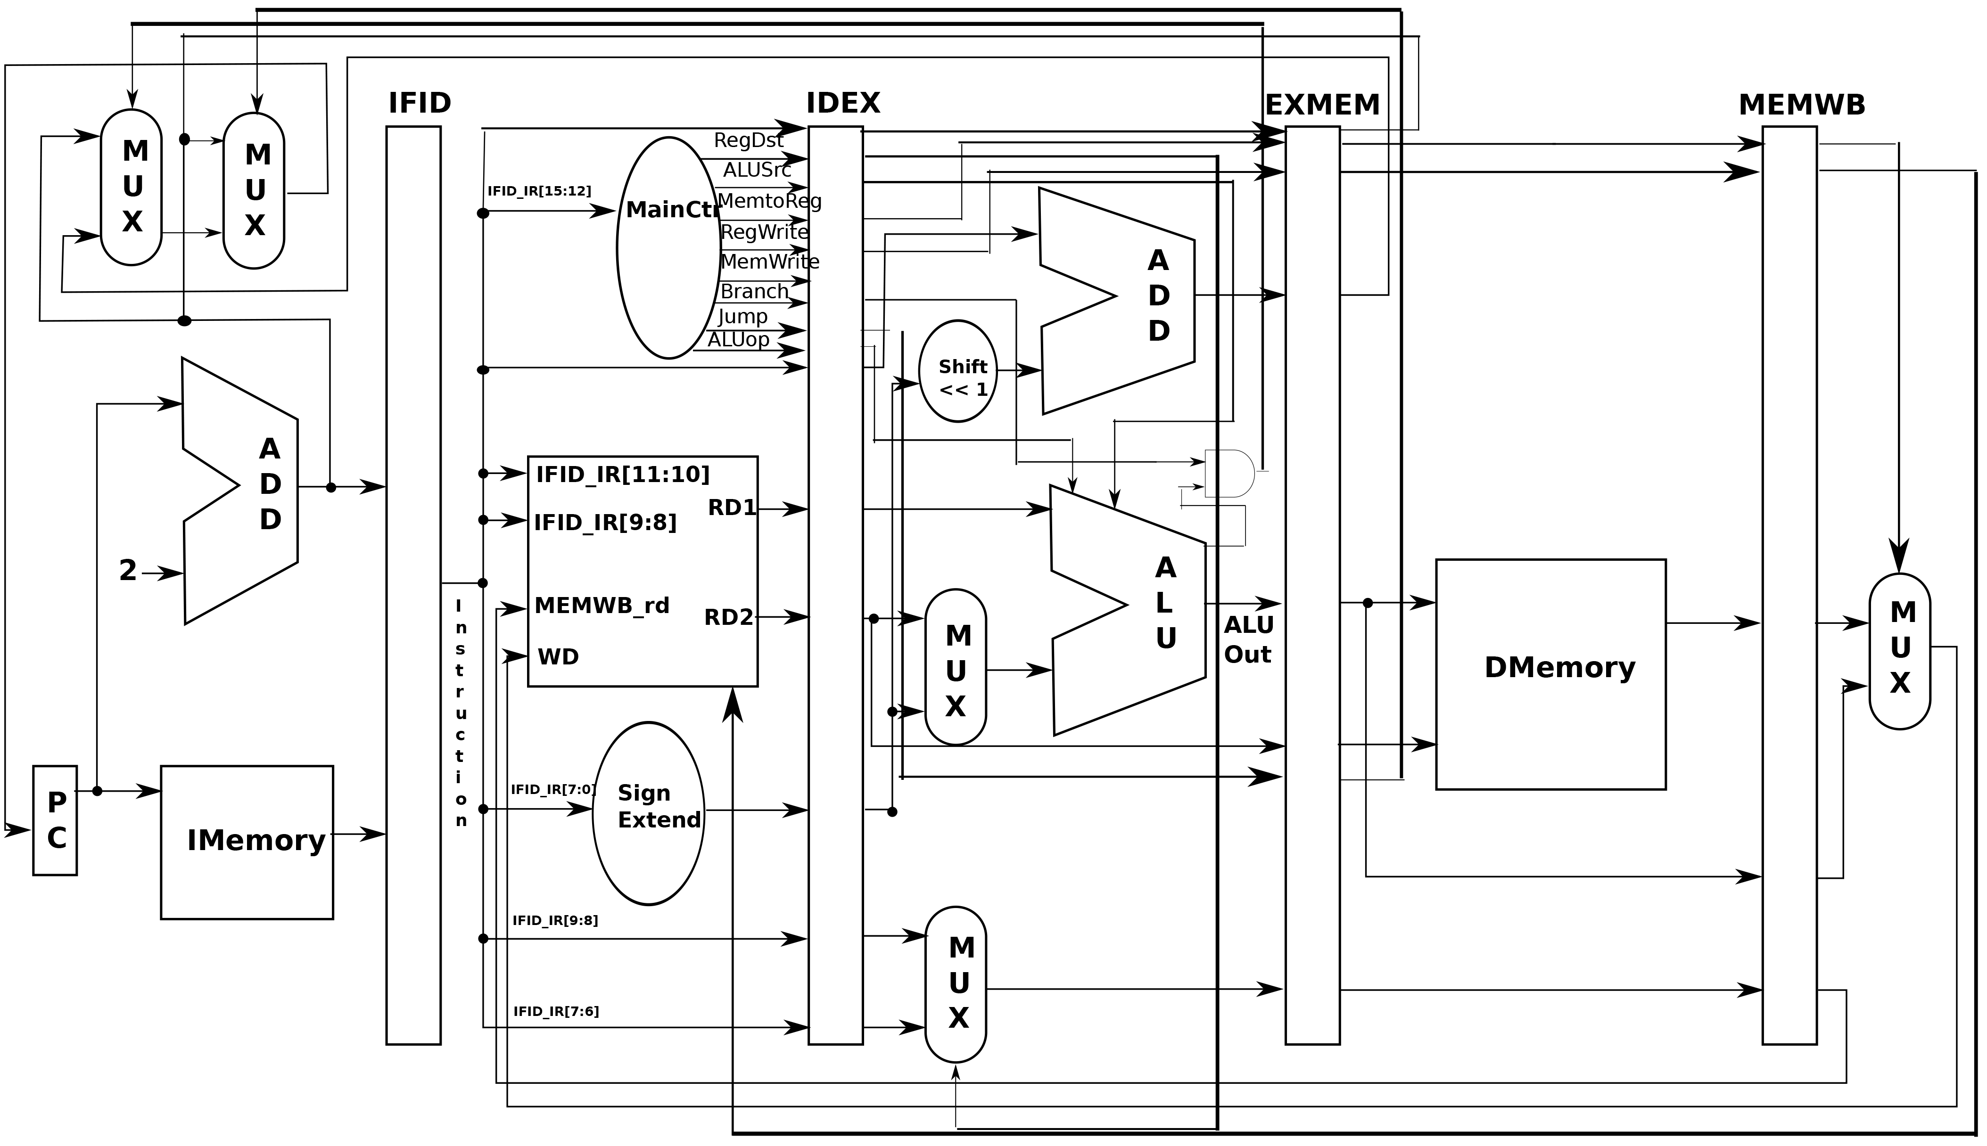
Single-cycle datapath

Slide 6
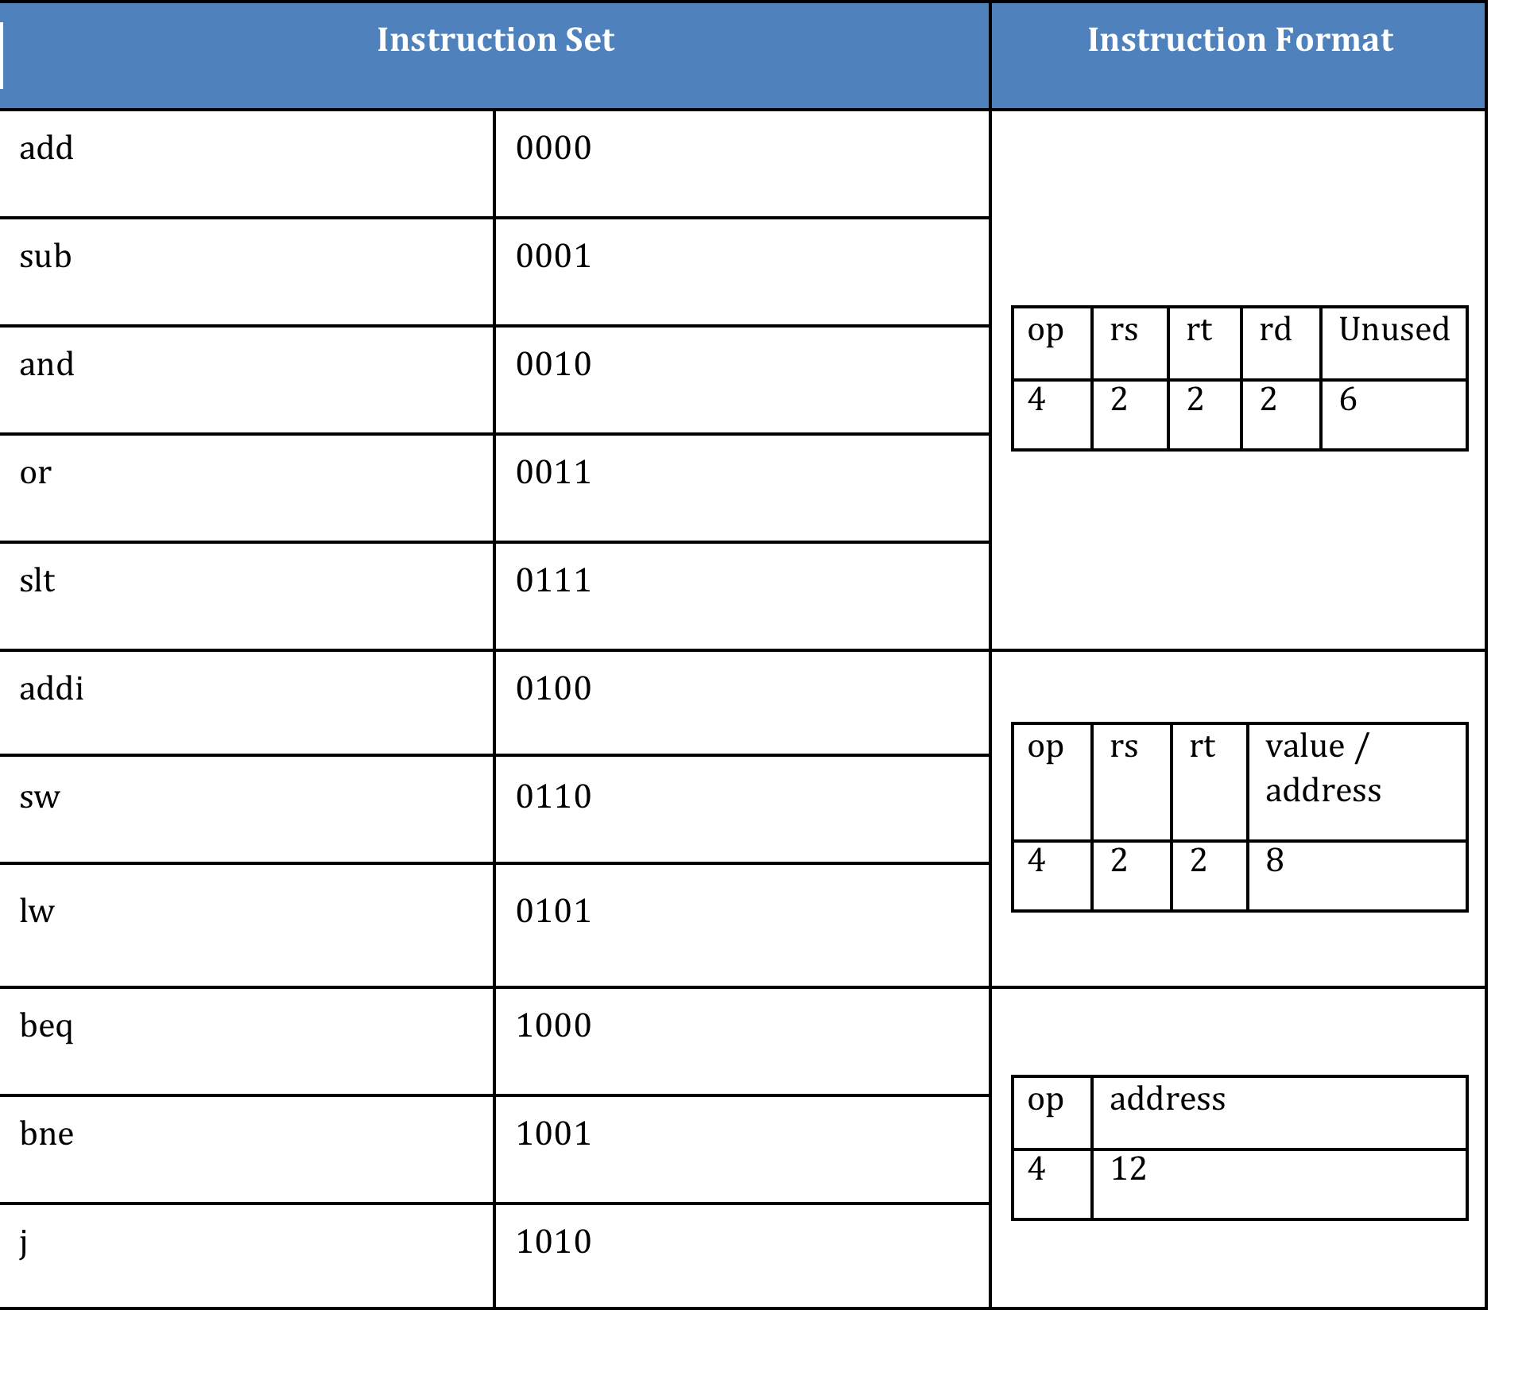
Instructions
Instructions are
assigned to
4-bit numbers
Three types:
R-type (Register)
I-type (Immediate)
J-type (Jump)

Slide 7
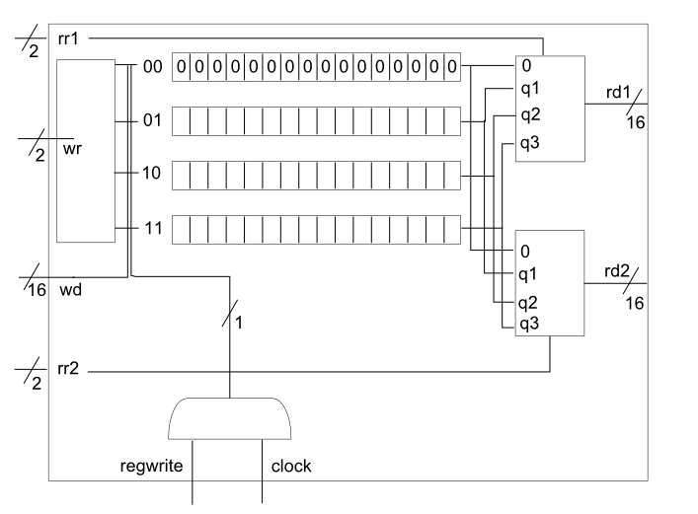
Components (Registers)
This CPU has 4 registers identified
by 2-bits: 00, 01, 10, 11 for
$0, $1, $2, $3.
$0 is read-only for the value 0.

Slide 8
Components (ALU)
Workhorse of the CPU
Strings together 16 separate 1-bit ALU’s to handle 16-bit data
Requires a unique significant bit ALU when chaining

Slide 9
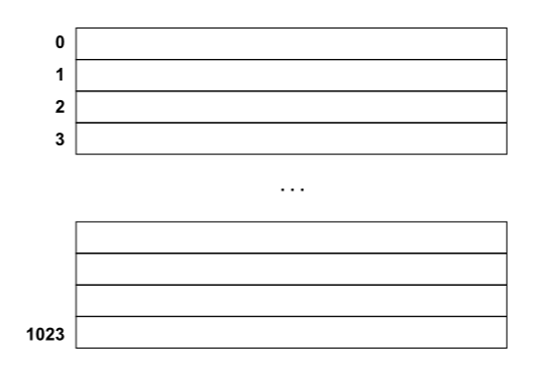
Components (Data Memory)
16-bit storage locations
Internally stored as an array
Can store up to 1024
pieces of data

Slide 10
Components (Pipelines)
Monitors the CPU during each cycle
Stores the results of each cycle to reduce hazards (called forwarding)
Makes for a more efficient process

Slide 11
Execution
lw $1, 0($0) lw $2, 2($0) add $2, $2, $1 addi $1, $1, 1 slt $3, $1, $2 beq $3, $0, 4 sw $1, 2($0) sw $2, 0($0) | lw $1, 0($0) lw $2, 2($0) sub $1, $1, $2 bne $1, $0, -5 sw $1, 2($0) beq $1, $0, 4 addi $t1, $0, 1 addi $t1, $0, 1 | addi $t1, $0, 1 addi $t1, $0, 1 lw $2, 2($0) addi $t1, $0, 3 addi $t2, $0, 1 sw $1, 0($0) sw $2, 2($0) j 0

Slide 12
Thank You!

